Slide 1


Presentation of Mini Project
Presented by :
1.Chandrakant singh (2302161520024)
2. Harsh Lathwal (2302161520030)
3. Harshit Maurya (2302161520031)
Guided By :
Ms. Neha Sharma Ma’am

Slide 2

NEWS Website : The GenZ Times
Empowering youth through NEWS

Slide 3
Introduction
Problem statement - News Website for the present generation who can read news on a particular topic with a wide range of thought view from different news portals.Most traditional news websites we get news according to a specific niche and according to a specific topic and also every website doesn't provide each and every news.
Motivation for project- To provide every news in the whole world about every topic just a click away.

Slide 4
Objective
Providing better experience
The primary objective of the project is to provide news from every corner of the world to each and every on in just one search not like our old websites were we cant find news on a particular topic and had to rely on multiple websites to find what we want. Our project can be a changing point of this old system.
Showcase Technical Expertise
To develop a news website that fetches and displays real-time news updates from external APIs, providing users with categorized and personalized news content in an organized and user-friendly interface.

Slide 5


Literature Review
Understand the Competition
With the growing reliance on digital platforms for news consumption, it is crucial to have a centralized platform providing real-time updates. APIs offer an efficient way to retrieve up-to-date information from multiple sources. This project aims to create a responsive and visually appealing website that aggregates and displays real-time news through API integration.
Prioritize Usability
Existing platforms like Google News and Flipboard highlight the importance of categorized and personalized news delivery. This project draws inspiration to deliver a lightweight yet powerful solution for web users.

Slide 6
Scope of the Project
In-Scope Features:
Frontend Development with HTML, CSS, and JavaScript:
HTML for structuring content on the page.
CSS for styling and responsive design, ensuring the website looks good on all devices.
JavaScript for dynamic functionality, data fetching, and interactive elements.
News API Integration:
Connect to a news API (such as NewsAPI or Mediastack) to pull real-time news data.
Parse and display data in various sections (e.g., Technology, Politics, Sports, etc.).
Categorized News Display:
Organize news articles by category to allow users to navigate quickly to topics of interest.
Include multiple sections on the homepage for different categories.
Basic Search Functionality:
Implement a search bar to allow users to find articles based on keywords.
Filter news results based on user input.
Pagination or Infinite Scroll:
Enable users to load more articles either through pagination or an infinite scroll feature.
Out-of-Scope Features:
Backend Development: This project does not include backend development; all data handling will be done client-side with JavaScript.No server or database will be implemented for storing user data or preferences.
User Authentication and Personalization: User login, profile creation, and personalized content (such as “saved articles”) are outside the scope of this project.
Content Generation and Editorial Control: The website will only display news content provided by the external API and will not allow custom editorial control or user-generated content.

Slide 7




Proposed Methodology
Research and Planning
1
Conduct in-depth research, analyze user needs, and develop a detailed project plan.
Design and Prototyping
Create high-fidelity wireframes, mockups, and interactive prototypes to refine the user experience.
2
Front-end Development
3
Create high-fidelity wireframes, mockups, and interactive prototypes to
refine the user experience.
Back-end Integration
Implement the website using modern web
technologies, ensuring pixel-perfect implementation.
4

Slide 8
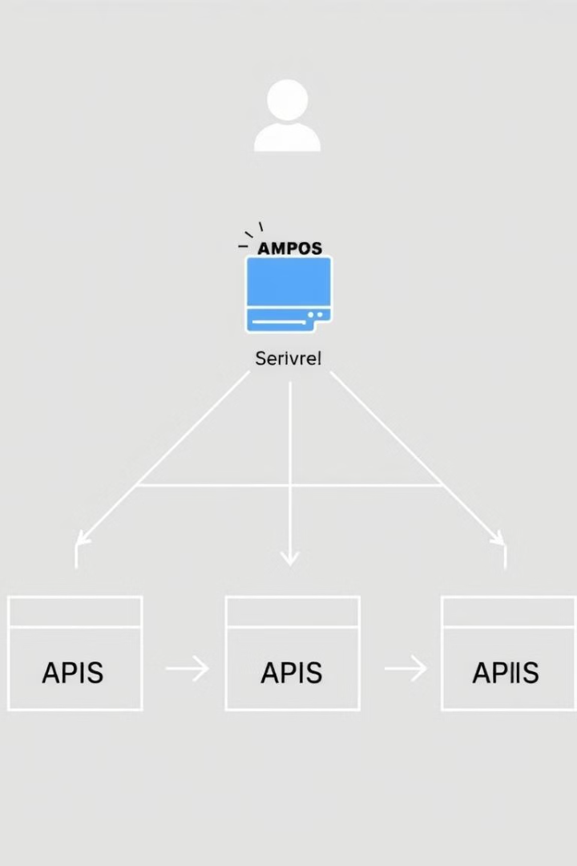
API Fundamentals
1
What is an API?
2
API Structure
An API (Application Programming Interface) is a set of protocols and tools for building software applications.
APIs define how software components should interact, allowing data exchange between systems.
3
API Types
Common API types include REST, SOAP, and GraphQL, each with its own unique features and use cases.

Slide 9
Selecting the Right API
Functionality
Documentation
Pricing
Evaluate the capabilities of an API to ensure it meets your website's content and feature requirements.
Comprehensive and well-organized API documentation is essential for efficient integration and troubleshooting.
Consider the API's pricing structure and align it with your website's budget and usage needs.

Slide 10

Integrating APIs into Your Website
1
1. Establish API Connection
Set up secure authentication and authorization to access the API's resources.
2
2. Fetch Data
Utilize the API's endpoints to retrieve the necessary data for your website's content.
3
3. Display Content
Seamlessly integrate the API-powered data into your website's user interface and layout.

Slide 11
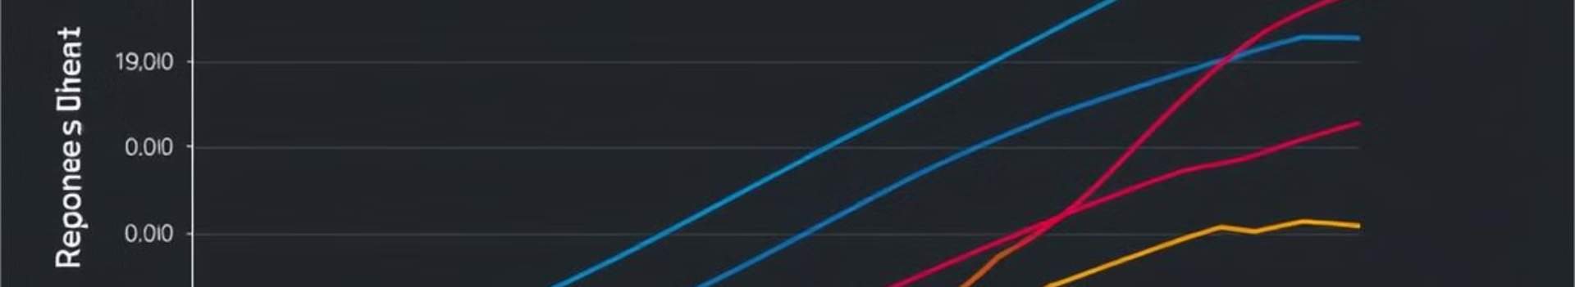
Optimizing API Performance
Caching
Pagination
Implement caching strategies to reduce the number of API calls and improve response times.
Use pagination to retrieve and display data in manageable chunks, minimizing the impact on API load.
Error Handling
Monitoring
Implement robust error handling to gracefully manage API failures and provide a seamless user experience.
Continuously monitor and analyze API performance metrics to identify and address any bottlenecks.

Slide 12





Securing Your API Integrations
Authentication
Encryption
Implement secure authentication mechanisms, such as API keys or OAuth, to control access to your API.
Use encryption protocols like HTTPS to protect the confidentiality of the data exchanged with the API.
Rate Limiting
Logging
Implement rate limiting to prevent API abuse and ensure fair usage among your website's users.
Maintain detailed logs of API requests and responses to aid in monitoring and troubleshooting.

Slide 13




Conclusion and Next Steps
Start Small
Begin by integrating a single API and gradually expand your website's API-powered features.
Continuously Optimize
Monitor and optimize your API integrations to maintain high performance and reliability.
Explore Emerging Trends
Stay informed about the latest API technologies and best practices to stay ahead of the curve.

Slide 14

Proposed methodology and system requirements
Programing cycle used - Html, CSS, JavaScript.
Tools used - Notepad and a laptop.
Hardware requirements-
1.PC with following specifications:
RAM : 4GB (Minimum)
Processor : Intel(R) Core(TM) i3-6100U CPU @ 2.30GHz 2.30 GHz.
Software requirements-
1. Html
2. CSS
3. JavaScript
4. API from news api.org

Slide 15
Expected Outcome
Pixel-Perfect Replica
1
Develop a website that accurately captures the visual aesthetic and interaction patterns of the original Apple website.
Seamless User Experience
2
Ensure the website provides a smooth and intuitive user journey, mirroring Apple's renowned design principles.
Robust Functionality
3
Implement a feature-rich website that handles product data, user accounts, and other core functionalities seamlessly.
Performance Optimization
4
4
Optimize the website for fast load times, scalability, and responsiveness across various devices and browsers.

Slide 16
Project Plan
Discovery and Planning
1
Conduct research, define requirements, and create a detailed project roadmap.
2
Design and Prototyping
Develop high-fidelity wireframes, mockups, and interactive prototypes for the website.
Front-end Development
3
Implement the website's user interface using the latest web technologies and frameworks.
4
Back-end Integration
Integrate the front-end with a robust back-end system to handle data and functionality.
Testing and Optimization
5
Thoroughly test the website for functionality, usability, and performance, making necessary improvements.

Slide 17

Conclusion
Conclusion
1
Possible Application Areas
2
Showcase of Expertise
3
Future Opportunities
General News Platform: Real-time updates from
diverse news categories.
Customized News Feeds: Personalized content based on user interests (e.g., sports, technology, etc.).
Educational Use: Teaching students how to work with APIs in web development.
This project will demonstrate our team's expertise in web design, development, and project management.
The successful completion of this project will open the door to new opportunities and potential collaborations.

Slide 18
References:-
https://www.w3schools.com/
Standard books:
1. Html : HTML5, CSS3 & Bootstrap 4 All-in-One
2. CSS : HTML5, CSS3 & Bootstrap 4 All-in-One
3. JavaScript : Learn to Code with JavaScript.
https://aws.amazon.com/whatis/api/#:~:text=API%20stands%20for%20Application%20Programming,other%20using%20requests%20and%20responses.
https://www.youtube.com/watch?v=-FldHnejaA4

Slide 19
THANKYOU

